Slide 1
CSE202: OBJECT ORIENTED PROGRAMMING
Static Members and Static Functions
Functions
Friend Function and Friend Class

Slide 2
Memory allocation for objects
We have studied that memory space for objects is allocated when they are declared and not when class is specified. All objects belong to a class use same member functions no separate space is allocated for member function when object is created.
Only space for member variables is allocated separately for each object.
Memory created when functions defined: common
Memory created when objects defined. Not common

Slide 3
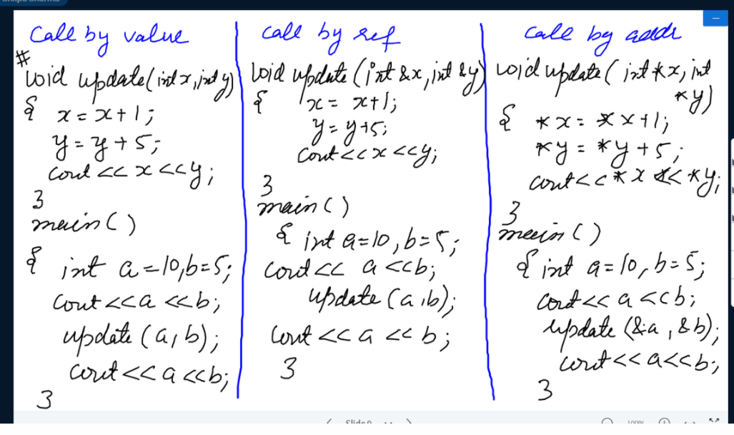

Slide 4
Static Data Members
It is initialized to zero when first object of its class is created . No other initialization is permitted.
Only one copy of that member is created for entire class and shared by all objects of that class.
Visible only within class but lifetime in entire program.
Static int age;

Slide 5
Static class member
class item
{ static int count;
int number;
public:
void getdata(int d)
{ number = d;
count++;
}
void getcount()
{
cout<<count;
}
};
Int item :: count; // definition of static data member
main(){
item a,b,c;
a.getcount();
b.getcount();
c.getcount();
a.getdata(100);
b.getdata(200);
c.getdata(300);
Cout<<“ after reading”;
a.getcount();
b.getcount();
c.getcount();
} OUTPUT
Count:0 0 0
After reading 3 3 3

Slide 6
Static member function
A static function can have access to only static members declared in same class
Can be called using class name instead of objects
Class-name :: function-name;

Slide 7
class test
{
int code;
static int count;
public:
void setcode()
{
code= ++count;
}
void showcode()
{
cout<<"Code: "<<code<<endl;
}
static void showcount()
{
cout<<"Count: "<<count<<endl;
}
};
int test :: count;
int main()
{
test t1,t2;
t1.setcode();
t2.setcode();
test :: showcount();
test t3;
t3.setcode();
test:: showcount();
t1.showcode();
t2.showcode();
t3.showcode();
}

Slide 8
True statements about inline function is/are
(I)Static function of a class can be called by class name using scope resolution operator i.e. : : (II)Static function can receive both static and non-static data members of a class (III)Static function is not the part of an object of a class
I and II
I only
I and III
I, II and III

Slide 9
True statements about inline function is/are
(I)Static function of a class can be called by class name using scope resolution operator i.e. : : (II)Static function can receive both static and non-static data members of a class (III)Static function is not the part of an object of a class
I and II
I only
I and III
I, II and III

Slide 10
Which function can be called without using an object of a class in C++
Static function
Inline function
Friend function
constant function

Slide 11
Which function can be called without using an object of a class in C++
Static function
Inline function
Friend function
constant function

Slide 12
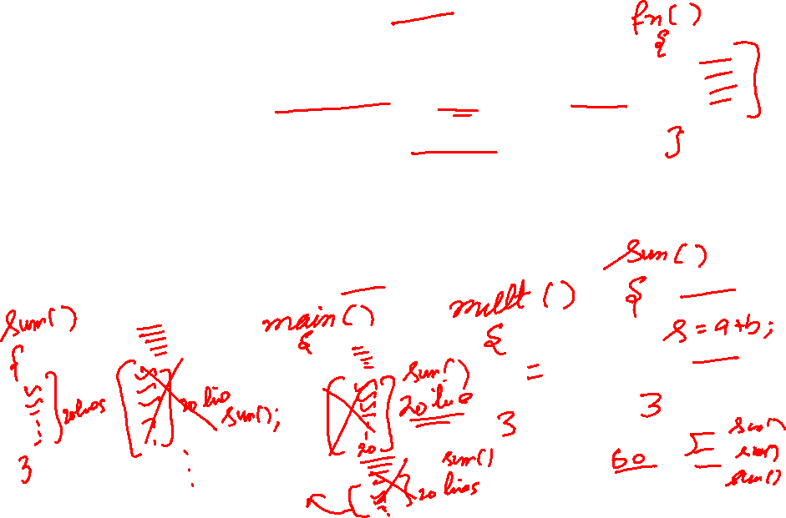
What is function????
Function is a self contained block of statements that perform a coherent task of some kind.
Every C++ program can be a thought of the collection of functions.
main( ) is also a function.

Slide 13
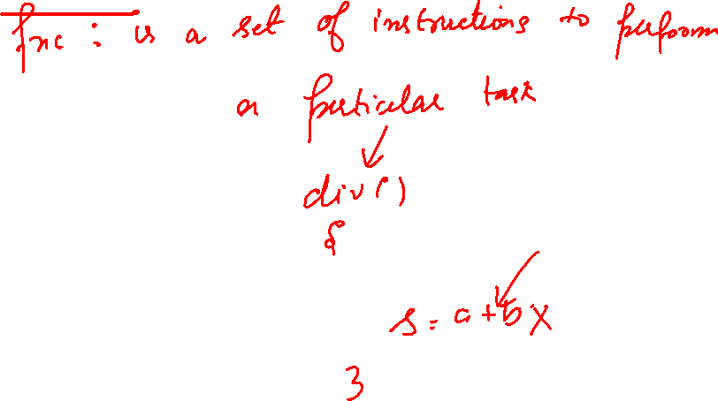

Slide 14
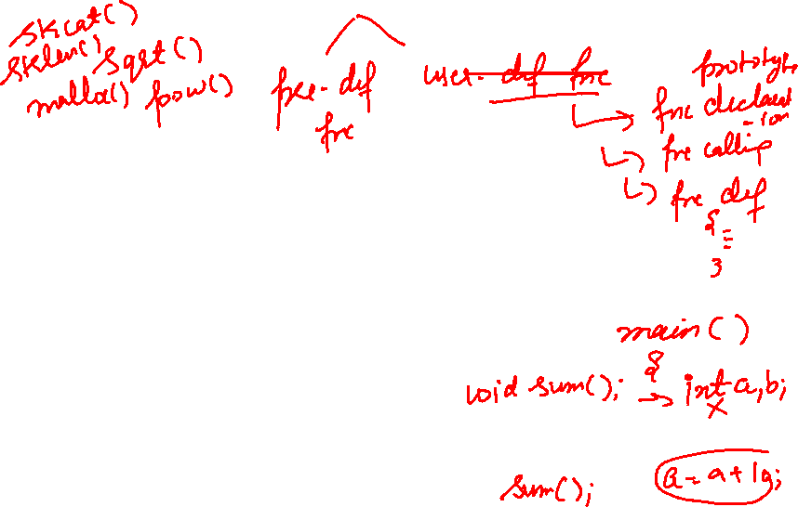
Types of Functions.
Library functions
These are the in- -built functions of ‘C++ ’library.
These are already defined in header files.
e.g. Cout<<; is a function which is used to print at output. It is defined in ‘iostream.h ’ file .
User defined functions.
Programmer can create their own function in C++ to perform specific task

Slide 15
Why use function?

Slide 16
Writing functions avoids rewriting of the same code again and again in the program.
Using function large programs can be reduced to smaller ones. It is easy to debug and find out the errors in it.
Using a function it becomes easier to write program to keep track of what they are doing.

Slide 17
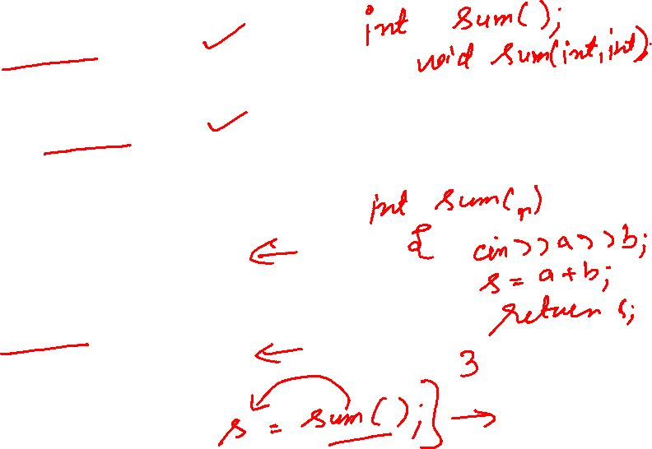
//Function Declaration retn_type func_name(data_type 1,data_type par2);
//Function Defination
rent_type func_name(data_type par1,data_type par2)
{
// body of the function
}
//Function Call
func_name(par1,par2);

Slide 18
Function prototype
A prototype statement helps the compiler to check the return type and arguments type of the function.
A prototype function consist of the functions return type, name and argument list.
Example
int sum( int x, int y);

Slide 19
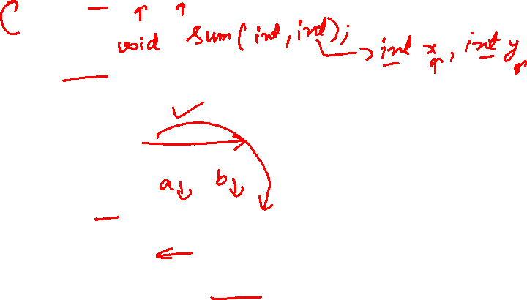
Example
#include<iostream.h>
#include<conio.h>
void sum(int, int); // function declaration
main()
{
int a, b;
cout<<“enter the two no”;
cin>>a>>b;
sum(a,b); // function calling
}
void sum( int x, int y) // function definition
{
int c=x+y;
cout<< “ sum is”<<c;
}

Slide 20
#include<conio.h>
int sum(int, int);
main()
{
int a=10,b=20;
int c=sum(a,b); /*actual arguments
Cout<<“sum is” << c;
getch();
}
int sum(int x, int y) /*formal arguments
{
int s;
s=x+y;
return(s); /*return value
}

Slide 21
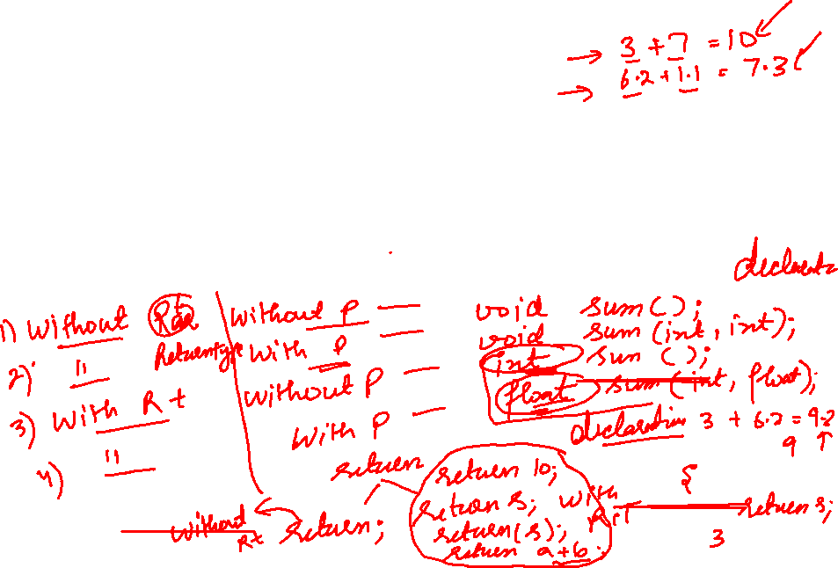
Categories of functions
A function with no parameter and no return value
A function with parameter and no return value
A function with parameter and return value
A function without parameter and return value

Slide 22
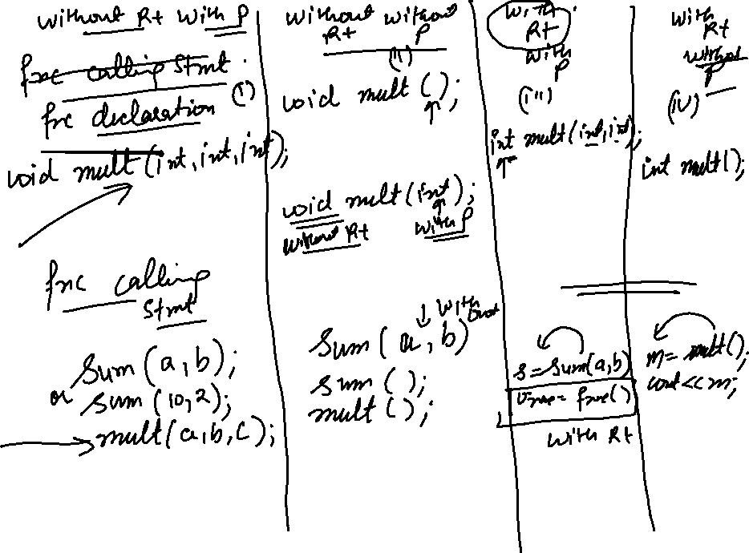

Slide 23
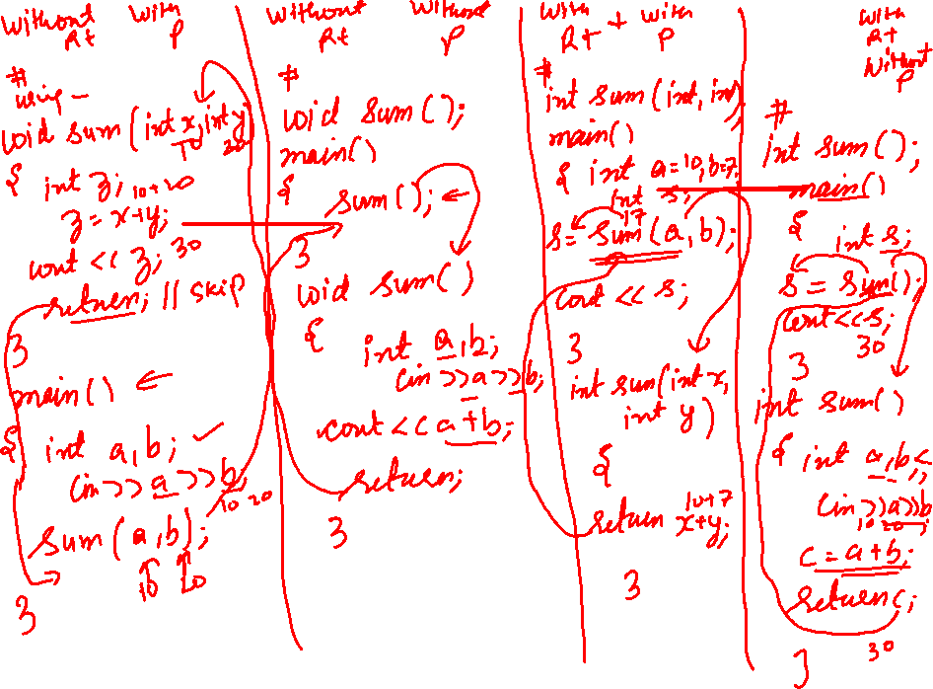

Slide 24
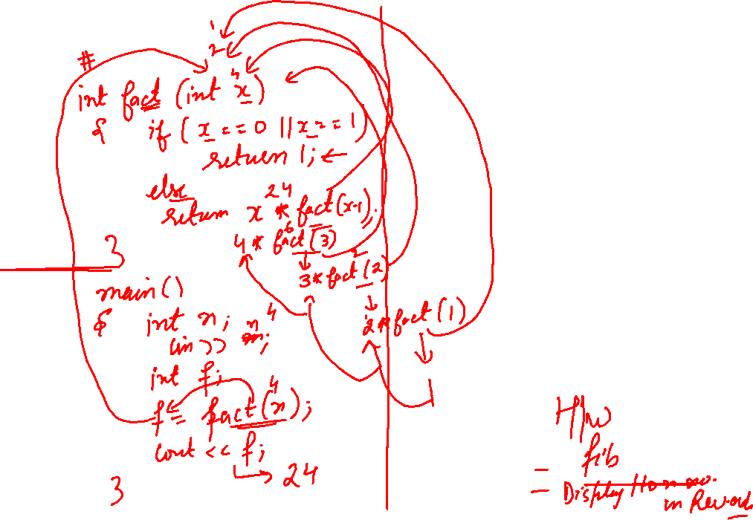

Slide 25
A function with no parameter and no return value
#include<conio.h>
main()
{
void print(); /*func declaration
cout<<“no parameter and no return value”;
print(); /*func calling
getch();
}
void print() /*func definition
{
for(int i=1;i<=30;i++)
{
cout<<“*”;
}
Cout<<“\n”;
}

Slide 26
A function with no parameter and no return value
There is no data transfer between calling and called function
The function is only executed and nothing is obtained
Such functions may be used to print some messages, draw stars etc

Slide 27
A function with parameter and no return value
#include<conio.h>
main()
{
int a=10,b=20;
void mul(int,int);
mul(a,b); /*actual arguments
getch();
}
void mul(int x, int y) /*formal arguments
{
int s;
s=x*y;
Cout<<“mul is” << s;
}

Slide 28
A function with parameter and return value
#include<conio.h>
void main()
{
int a=10,b=20,c;
int max(int,int);
c=max(a,b);
Cout<<“greatest no is” <<c;
getch();
}
int max(int x, int y)
{
if(x>y)
return(x);
else
{
return(y);
}
}

Slide 29
A function without parameter and return value
#include<conio.h>
main()
{
int a=10,b=20;
int sum();
int c=sum(); /*actual arguments
Cout<<“sum is”<< c;
getch();
}
int sum() /*formal arguments
{
int x=10,y=20;
return(x+y); /*return value
}

Slide 30
Default arguments
In the function prototype declaration , the default values are given. Whenever a call is made to function without specifying an argument , the program will automatically assign values to the parameters from the default function prototype.
Default arguments facilitate easy development and maintenance of programs.

Slide 31
#include<iostream>
void sum(int x=10, int y=20);
main()
{
int a, b;
sum();
}
void sum(int a1=10,int a2=20)
{
temp= a1+a2;
}

Slide 32
Default Arguments
#include <iostream>
using namespace std;
void display(char = '*', int = 1);
int main()
{
cout<<"No argument passed:\n";
display();
cout<<"\n\nFirst argument passed:\n";
display('#');
cout<<"\n\nBoth argument passed:\n";
display('$', 5);
return 0;
}
void display(char c, int n){
for(int i = 1; i <=n; ++i) {
cout<<c;
}
cout<<endl;
}

Slide 33
SCOPE RULES
Local Variable
Global variable
Local Variables are defined inside the function body or in a compound statement. The scope of these variables are inside the function where they are defined.
Eg: int fact (int n)
{
Int i, fact, j; // i, j are local variables.
-----
----
}

Slide 34
Global variables are those variables whose scope is available through out the program.

Slide 35
FUNCTION OVERLOADING

Slide 36
Overloading in C++
What is overloading
– Overloading means assigning multiple
meanings to a function name or operator
symbol
– It allows multiple definitions of a function with the same name, but different signatures.
C++ supports
– Function overloading
– Operator overloading

Slide 37
Why is Overloading Useful?
Function overloading allows functions that
conceptually perform the same task on
objects of different types to be given the
same name.
Operator overloading provides a convenient
notation for manipulating user-defined
objects with conventional operators.

Slide 38
Function Overloading
Is the process of using the same name for two or more functions
Requires each redefinition of a function to use a different function signature that is:
different types of parameters,
or sequence of parameters,
or number of parameters
Is used so that a programmer does not have to remember multiple function names

Slide 39
Void sum(int,int);
Void sum(double,double);
Void sum(char,char);
main()
{
int a=10,b=20 ;
double c=7.52,d=8.14;
char e=‘a’ , f=‘b’ ;
sum(a,b);
sum(c,d);
sum(e,f);
}
void sum(int x, int y)
{
cout<<“\n sum of integers are”<<x+y;
}
void sum(double x, double y)
{
cout<<“\n sum of two floating no are”<<x+y;
}
void sum(char x, char y)
{
cout<<“\n sum of characters are”<<x+y;
}

Slide 40
#include<iostream> using namespace std; void f1(); void f2(); int a=20; main() {a=30; cout<<a; { a=35; cout<<a; } f1(); cout<<a; f2(); cout<<a; }
void f1() { a=60; cout<<a; } void f2() { a=70; cout<<a; }

Slide 44
Output:
Sum of integers 30
sum of two floating no are 15.66
sum of characters are 195

Slide 45
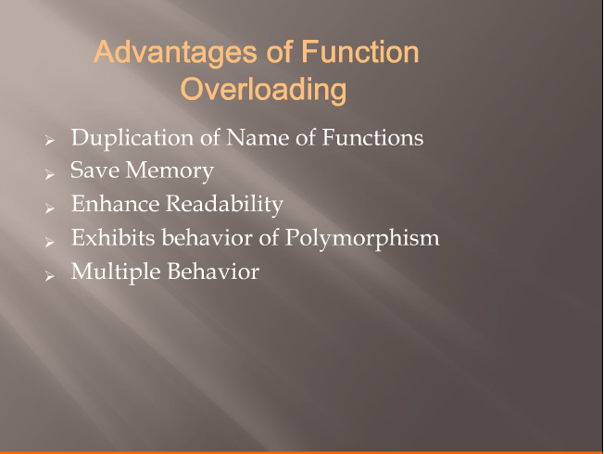

Slide 46
Friend Functions and Friend Classes
Data hiding is a fundamental concept of object-oriented programming. It restricts the access of private members from outside of the class.
Similarly, protected members can only be accessed by derived classes and are inaccessible from outside.
However, there is a feature in C++ called friend functions that break this rule and allow us to access member functions from outside the class.
Similarly, there is a friend class as well, which we will learn later
friend function of a class
Defined outside that class’s scope.
Not a member function of that class.
has the right to access the non-public and public members of that class.
Standalone functions or entire classes may be declared to be friends of a class.
Can enhance performance.
Often appropriate when a member function cannot be used for certain operations.

Slide 47
friend Function in C++
A friend function can access the private and protected data of a class. We declare a friend function using the friend keyword inside the body of the class.
class className
{
... .. ...
friend returnType functionName(arguments);
... .. ...
}

Slide 48
A friend function possesses certain special characteristics:
It is not in the scope of the class to which it has been declared as friend.
Since it is not in the scope of the class, it cannot be called using the object of that class.
It can be invoked like a normal function without the help of any object.
Unlike member functions, it cannot access the member names directly and has to use an object name and dot membership operator with each member name (e.g., A.x)
It can be declared either in public or private part of a class without affecting its meaning.
Usually, it has the objects as arguments.

Slide 49
class sample
{
int a,b;
public:
void setvalue() { a=10; b=40; }
friend float mean (sample s);
};
float mean(sample s)
{
return float(s.a + s.b)/2;
}
main()
{
sample x;
x.setvalue();
cout<<“mean is”<< mean(x);
}

Slide 50
Where does keyword ‘friend’ should be placed?
A. function declaration B. function definition C. main function D. block function

Slide 51
Where does keyword ‘friend’ should be placed?
A. function declaration B. function definition C. main function D. block function

Slide 52
Example 2: Add Members of Two Different Classes
// Add members of two different classes using friend functions
#include <iostream>
using namespace std;
// forward declaration
class ClassB;
class ClassA {
private:
int a;
public:
void ipa() { a=10;}
// friend function declaration
friend int add(ClassA, ClassB);
}A;
class ClassB {
private:
int b;
// friend function declaration
friend int add(ClassA, ClassB);
public:
void ipb() {b=20;}
}B;
// access members of both classes
int add(ClassA objectA, ClassB objectB) {
int s;
s=objectA.a + objectB.b;
return (s);
}
main() {
A.ipa(); B.ipb();
cout << "Sum: " << add(A,B);
}

Slide 53
Which of the following is correct about friend functions?
A. Friend functions use the dot operator to access members of a class using class objects B. Friend functions can be private or public C. Friend cannot access the members of the class directly D. All of the above

Slide 54
Which of the following is correct about friend functions?
A. Friend functions use the dot operator to access members of a class using class objects B. Friend functions can be private or public C. Friend cannot access the members of the class directly D. All of the above

Slide 55
A friend function can be
A. A method of another class B. A global function C. Both A and B D. None of the above

Slide 56
A friend function can be
A. A method of another class B. A global function C. Both A and B D. None of the above

Slide 57
Function friendly to two classes
# include<iostream>
using namespace std;
class ABC; //forward declaration
class XYZ
{
int x;
public:
void setvalue(int i) { x=i;}
friend void max(XYZ, ABC);
};
class ABC
{
int a;
public:
void setvalue(int i) { a=i;}
friend void max(XYZ, ABC);
};
void max(XYZ m, ABC n) //Definition of friend
{
if(m.x>= n.a)
cout<<m.x;
else
cout<<n.a;
}
int main()
{
ABC abc;
abc.setvalue(10);
XYZ xyz;
xyz.setvalue(20)
max(xyz,abc);
return 0;
}
OUTPUT:
20

Slide 58
Swapping Private data of classes
# include<iostream>
using namespace std;
class class_2;
class class_1
{
int value1;
public:
void intdata(int a) { value1=a;}
void display(void) { cout<<value1<<‘\n”; }
friend void exchange(classes_1 &, classes_2 &);
};
void exchange(class_1 & x, class_2 & y)
{
int temp = x.value1;
x.value1 = y.value2;
y.value2 = temp;
}
int main()
{
class_1 C1;
class_2 C2;
C1.indata(100);
C2.indata(200);
cout<<“Values before exchange”<“\n”;
C1.display();
C2.display();
exchange(C1,C2); //swapping
cout<<“values after exchange”<<“\n”;
C1.display();
C2.display();
return 0;
}
OUTPUT:
Values before exchange
100
200
Values after exchange
200
100

Slide 59
friend class
Declare all the member functions of one class as the friend functions of another class. In such cases, the class is called a friend class.
A friend class is a class whose members have access to the private or protected members of another class
This can be specified as follows:
class Z
{
.........
friend class X; //all member functions of X are
// friends to Z
};

Slide 60
#include<iostream>
using namespace std;
class A
{
int a,b;
public:
void output()
{
cout<<a<<endl<<b;
}
friend class B;
};
class B
{
int c;
public:
void ip(A &obj)
{
obj.a=23;
obj.b=24;//cin>>obj.b
}
};
main()
{
A objA;
B obj1;
obj1.ip(objA);
objA.output();
}

Slide 61
What is the syntax of friend class?
friend classA class;
friend class;
friend classA;
friend class2->friend;
friend class ClassA

Slide 62
What is the syntax of friend class?
friend classA class;
friend class;
friend classA;
friend class2->friend;
friend class ClassA

Slide 63
A friend class can access ____________________ members of other class in which it is declared as friend.
A. private B. protected C. public D. Both A and B

Slide 64
A friend class can access ____________________ members of other class in which it is declared as friend.
A. private B. protected C. public D. Both A and B

Slide 65
If class A is a friend of B, then B doesn’t become a friend of A automatically.
A. TRUE B. FALSE C. Can be true and false D. Can not say

Slide 66
If class A is a friend of B, then B doesn’t become a friend of A automatically.
A. TRUE B. FALSE C. Can be true and false D. Can not say

Slide 67
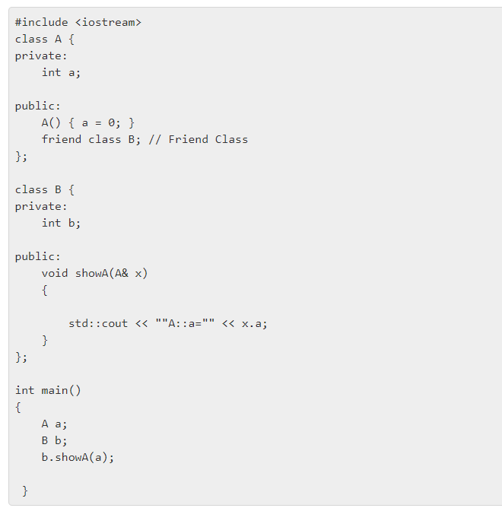
A. A::a=0 B. A C. a=0 D. A::0

Slide 68
A. A::a=0 B. A C. a=0 D. A::0

Slide 69
How many member functions in the following code?
class Box {
int capacity;
public:
void print();
friend void show();
bool compare();
friend bool lost();
};
A. 1 B. 2 C. 3 D. 4

Slide 70
How many member functions in the following code?
class Box {
int capacity;
public:
void print();
friend void show();
bool compare();
friend bool lost();
};
A. 1 B. 2 C. 3 D. 4

Slide 71
friend Functions and friend Classes
To declare a function as a friend of a class:
Provide the function prototype in the class definition preceded by keyword friend.
To declare a class as a friend of another class:
Place a declaration of the form
friend class ClassTwo; in the definition of class ClassOne
All member functions of class ClassTwo are friends of class ClassOne.
Friendship is granted, not taken.
For class B to be a friend of class A, class A must explicitly declare that class B is its friend.
Friendship relation is neither symmetric nor transitive
If class A is a friend of class B, and class B is a friend of class C, you cannot infer that class B is a friend of class A, that class C is a friend of class B, or that class A is a friend of class C.
It is possible to specify overloaded functions as friends of a class.
Each overloaded function intended to be a friend must be explicitly declared as a friend of the class.

Slide 72
Pointers and classes
Pointers are variables which hold the memory address of other variable. The use of pointers in classes is similar to that of pointer used with structure.
By using pointers any member function can be accessed by two methods:
(*ptr).function_name;
Or
Ptr->function_name;

Slide 73
Example
main()
{
class student
{
private:
int r;
char n[30];
public:
void getdata()
{
cout<<"enter rollno=";
cin>>r;
cout<<"enter name=";
cin>>n;
}
void display()
{ cout<<"rollno="<<r; cout<<"name="<<n;
}
};
class student abc;
class student *ptr;
ptr=&abc;
(*ptr).getdata();
ptr->display();
getch();
}

Slide 74
Class containing pointer
class complex
{
float real, imag;
public:
void get();
void sum(complex*,complex*);
void show();
};
void complex::get()
{ cin>>real;
cin>>imag;
}
void complex::sum(complex *c1,complex *c2)
{ real=c1->real+c2->real;
//( member access through pointer)
imag=c1->imag+c2->imag;
}
void complex ::show()
{ cout<<real<<"+ i"<<imag;
}
main()
{ complex c1,c2,c3;
c1.get();
c2.get();
c1.show();
c2.show();
c3.sum(&c1,&c2);
c3.show();
}

Slide 75
cout<<"\nEnter any string";
fflush(stdin);
gets(s1);
cout<<"No is:"<<a<<endl;
cout<<"with setw:"<<setw(8)<<a<<endl;
cout<<"With setfill:"<<setw(9)<<setfill('*')<<a<<endl;
cout<<"Decimal base:"<<dec<<a<<endl;
cout<<"Octal base:"<<oct<<a<<endl;
cout<<"Hexadecimal base:"<<hex<<a<<endl;
cout<<"Enter the float no:";
cin>>f;
cout<<"with setprecision:"<<setprecision(4)<<f<<endl;
cout<<"lovely"<<ends;
cout<<"professional"<<endl;
cout<<"University";
cout.flush();
}

Slide 76
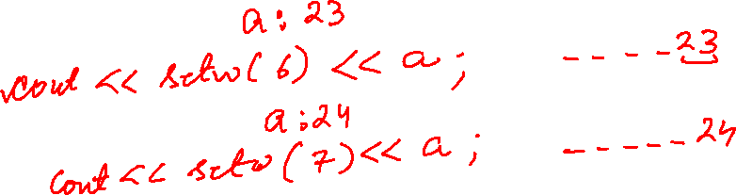

Slide 77
